Slide 1
Fresher Training-Project Work
Nutrition App
Prepared by:
Pankaj Sharma

Slide 2

Problem Statement
You need to create an application for Nutrition App
Customer can sign up and sign in with the application, provide body composition and check his nutrition plan.
Admin Should be able to perform below operations
Customer Management
Nutrition plan management
Exercise Management
Food Management
Calories Log
Weight Log
Payment Management

Slide 3

Road Map
Technologies involved
Application will be developed in below sprints
Core Java + JDBC + MySQL + Junit + Maven App
Servlet & JSP + HTML +CSS +JS
Spring Boot + React +Redux + Bootstrap4 + Integration of Previous Sprint

Slide 4
Plan
Design
Generate the skeleton as per class diagram. [Design the class diagram and show first, get approval on the same]
TDD Approach
Identify the test cases for each module
Create Excel for all the test cases, get it approved.
Write the test cases as per the excel plan
Implement the case study in incremental manner

Slide 5
Module
User Module
Nutrition Plan Module
Diet Plan Module
Weight Log Module
Payment Module

Slide 6
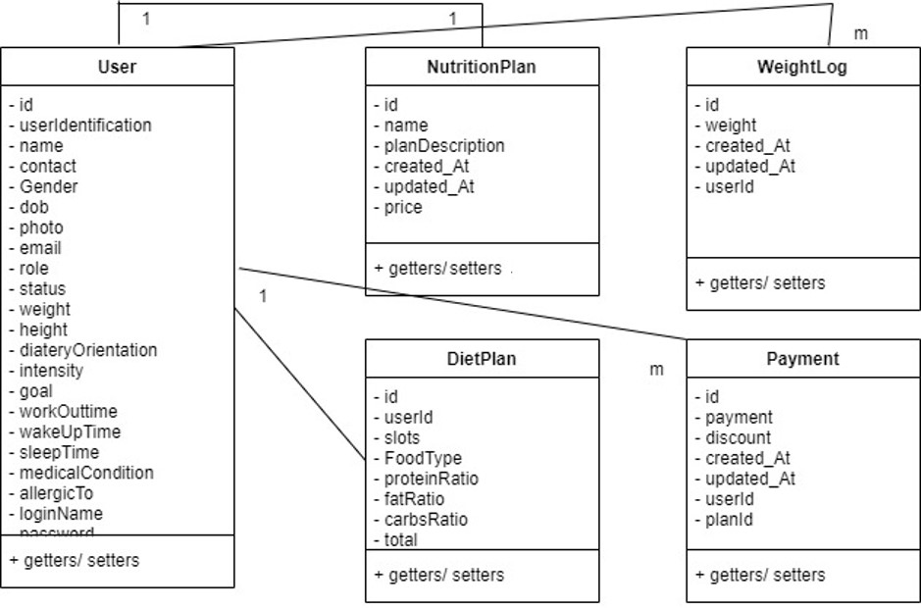
Class Design - Pojos

Slide 7
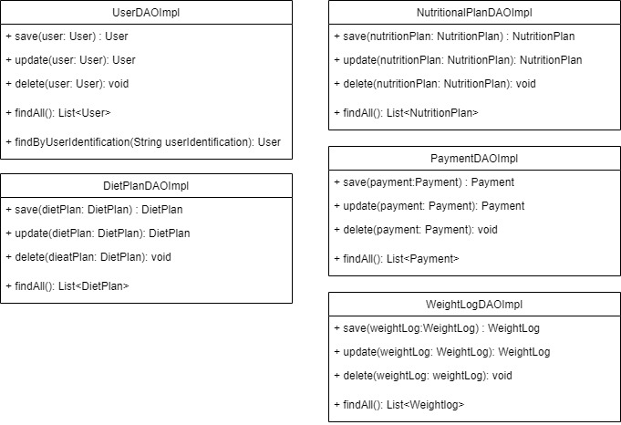
Class Design - Repository

Slide 8
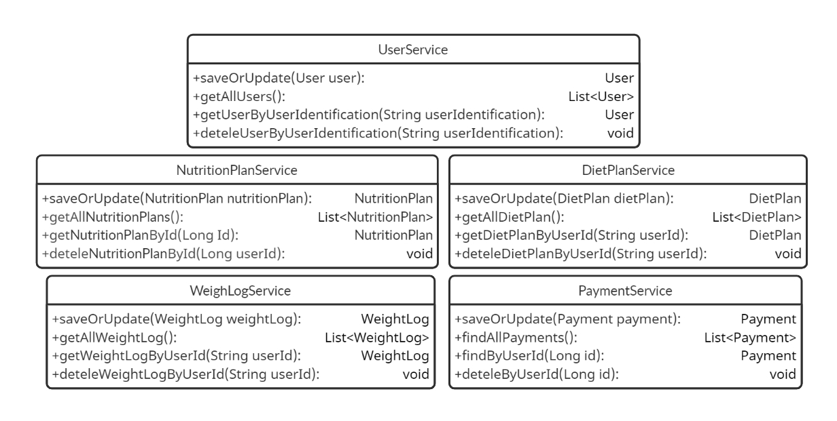
Class Design - Service

Slide 9
Thank you!

